Slide 1
scRNA-seq Integration and Differential Expression Workshop
Working with treatment versus control data

Slide 2
Learning Outcomes
Understand and get comfortable using various integration strategies
Understand all DE functions offered by Seurat and when to use them: FindMarkers(), FindConservedMarkers(), and FindAllMarkers()
Learn how to use DE tools meant for bulk data (e.g. DESeq2 and limma) for single cell ‘pseudobulk’ data, and understand why you might choose this approach
Learn different ways to visualise DEGs using both in-built Seurat functions and external packages (pheatmap)

Slide 3
Software and Package Requirements
R (v4.3.0)
RStudio
R packages:
Seurat (v5.0.1)
DESeq2 (v1.42.1)
tidyverse (v2.0.0)
SeuratData (v0.2.2.9001)
pheatmap (v1.0.12)
grid (v4.0.3)

Slide 4
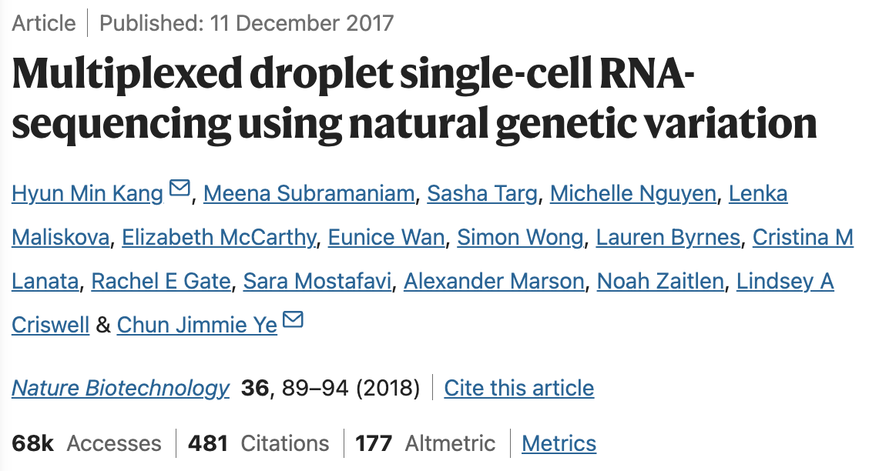
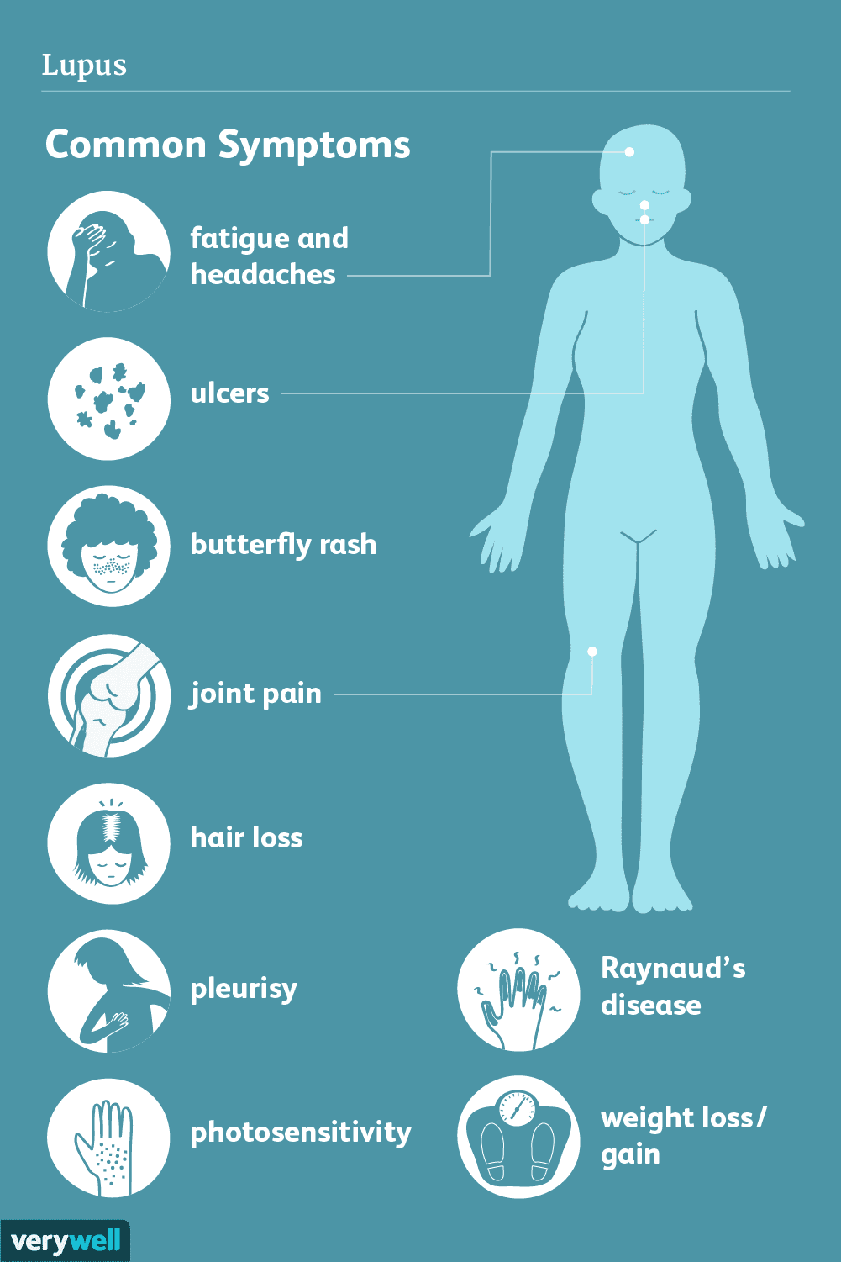
Study Design
Peripheral Mononuclear Blood Cells (PBMCs) were sequenced using scRNA-seq from 8 lupus patients. Patients were randomly split into a treatment and control group. The treatment group received interferon beta.
Goals of our analysis:
Integrate data, so that batch effects are removed and similar cell types across both conditions are grouped together.
Identify upregulated genes in cell-types in a treatment versus control experiment.
Identify and visualise genes that are differentially expressed between conditions in a particular cell type
Conduct differential expression analysis using an alternative ‘pseudobulk’ approach

Slide 5
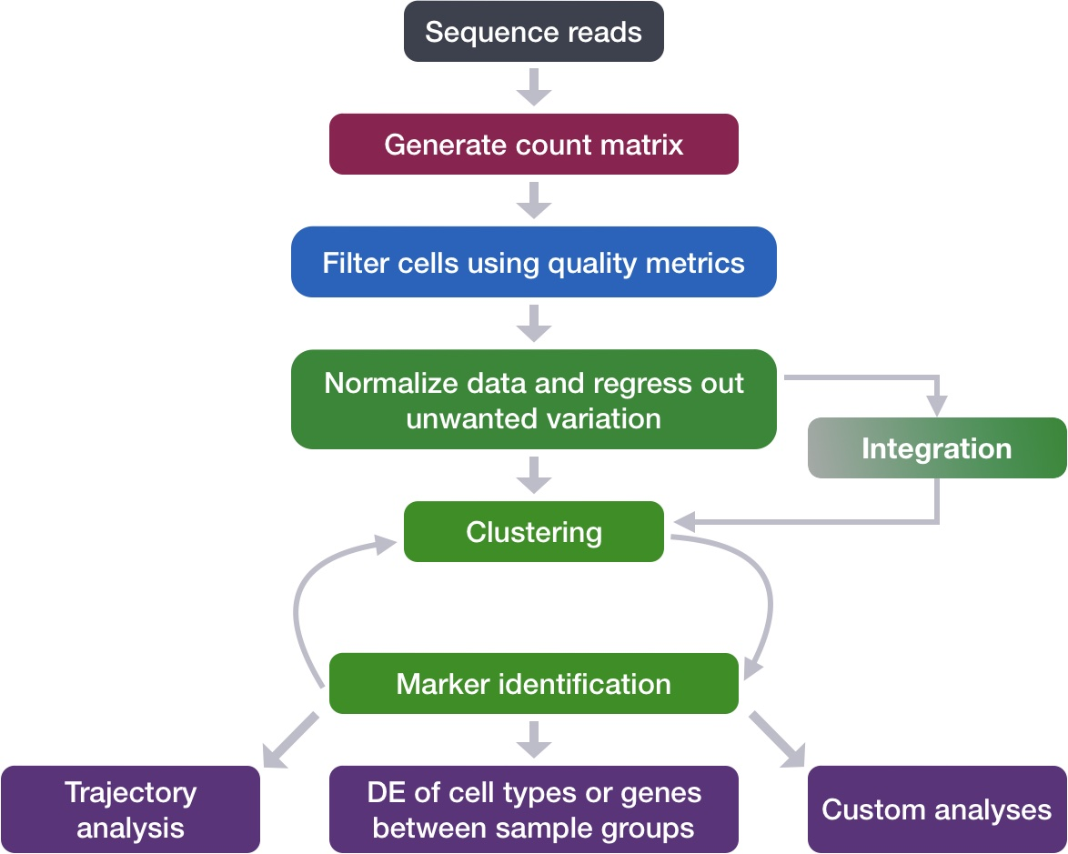
Refresher: General scRNA-seq Workflow
Normalise and Scale Data
Mary Piper, Meeta Mistry, Jihe Liu, William Gammerdinger, & Radhika Khetani. (2022, January 6). hbctraining/scRNA-seq_online: scRNA-seq Lessons from HCBC (first release). Zenodo. https://doi.org/10.5281/zenodo.5826256.

Slide 6
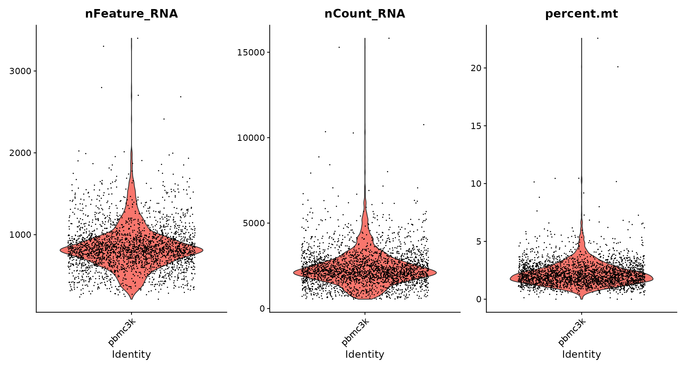
Guidelines for removing low quality cells
Low quality cells or empty droplets will have fewer genes and fewer counts
Cell doublets (>1 cell assigned to a single barcode) will have significantly more genes and counts
Dying cells will have higher mitochondrial contamination
(<=5% is a good guideline)
We can use violin plots to determine thresholds for filtering based on these metrics
Notes:
For information: https://www.ncbi.nlm.nih.gov/pmc/articles/PMC4758103/

Slide 7
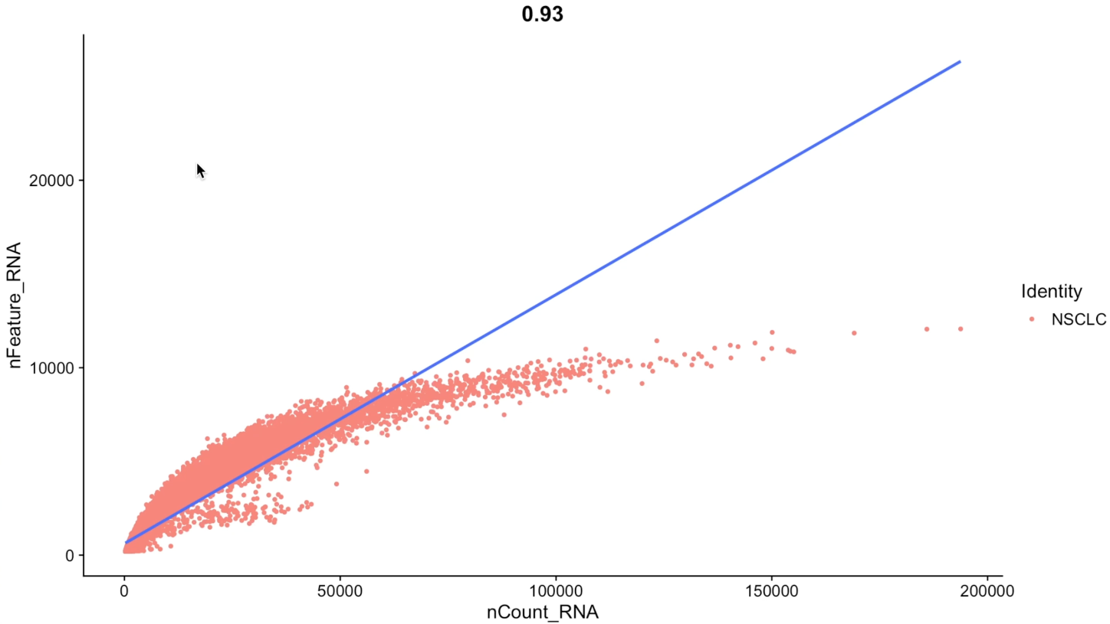
Consider Metrics Together: Feature and Molecule Association Plots
X axis = number of transcripts/counts per cell
Y axis = number of unique genes per cell
Generally, for good quality data, we expect a strong positive correlation between the number of counts and unique genes.
Using the line as a guide, we can figure out cells that are potentially lower quality
Cells in the bottom right quadrant indicates you’ve captured a few number of genes that are being sequenced over and over again
Cells in the top left quadrant indicates you’re capturing many genes but not sequenced deep enough
Notes:
More information here: https://www.embopress.org/doi/full/10.15252/msb.20188746#sec-2

Slide 8
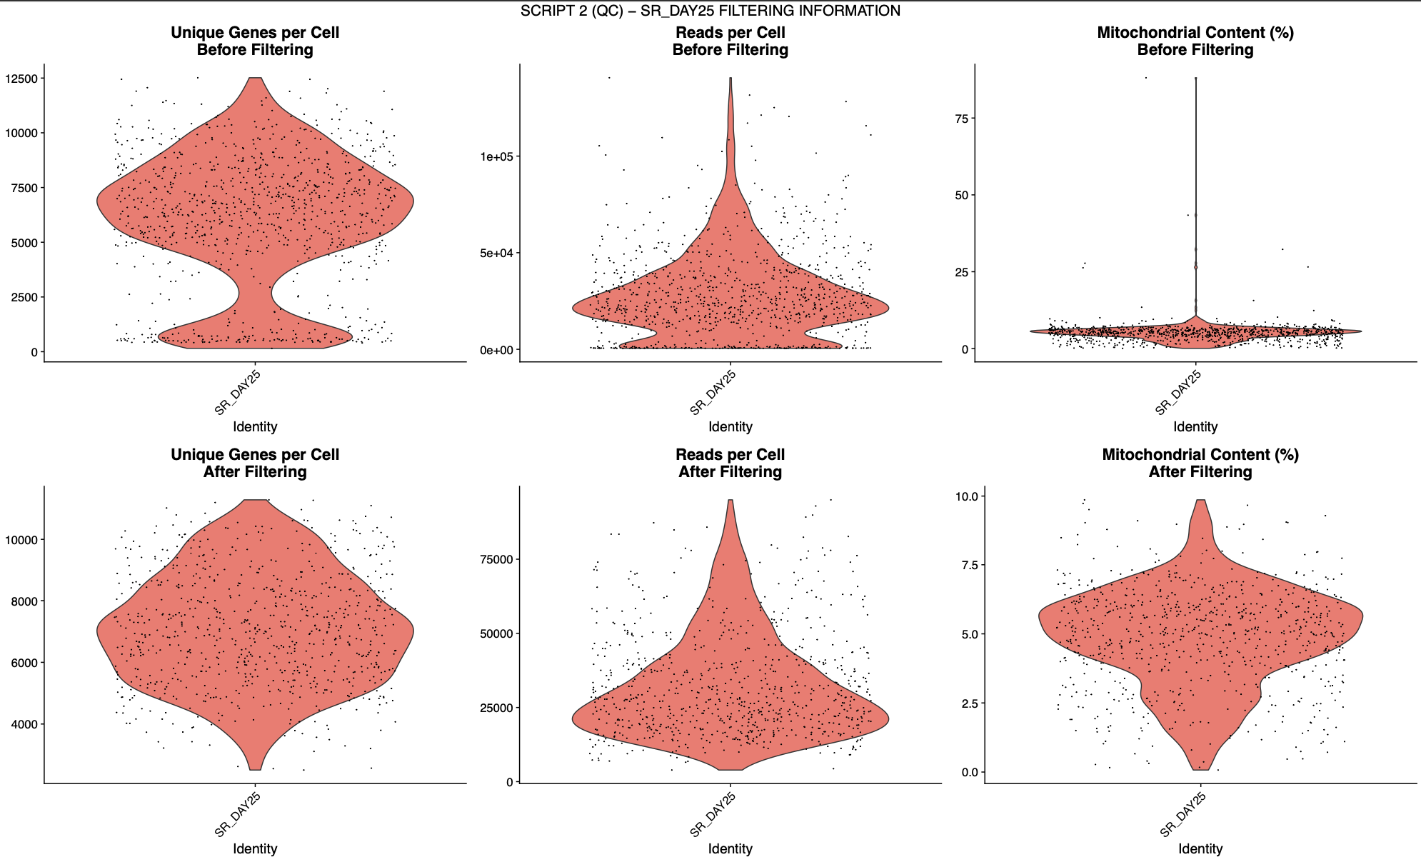
Example Before and After QC Plots

Slide 9
Integration – What, When, Why?
Normalise and Scale Data
Mary Piper, Meeta Mistry, Jihe Liu, William Gammerdinger, & Radhika Khetani. (2022, January 6). hbctraining/scRNA-seq_online: scRNA-seq Lessons from HCBC (first release). Zenodo. https://doi.org/10.5281/zenodo.5826256.

Slide 10
Integration – What, When, Why?
When comparing 2 Experimental Groups (e.g., Treatment/Control, KO/WT), we want to:
Identify shared cell subpopulations across both datasets.
Obtain conserved cell-type markers in both control and stimulated cells.
Compare datasets to reveal cell-type specific responses to stimulation/condition.
These steps rely on integration—a process that aligns shared cell states across datasets, enhancing statistical power and enabling these comparative analyses across multiple scRNA-seq datasets.
Notes:
https://satijalab.org/seurat/articles/integration_introduction

Slide 11
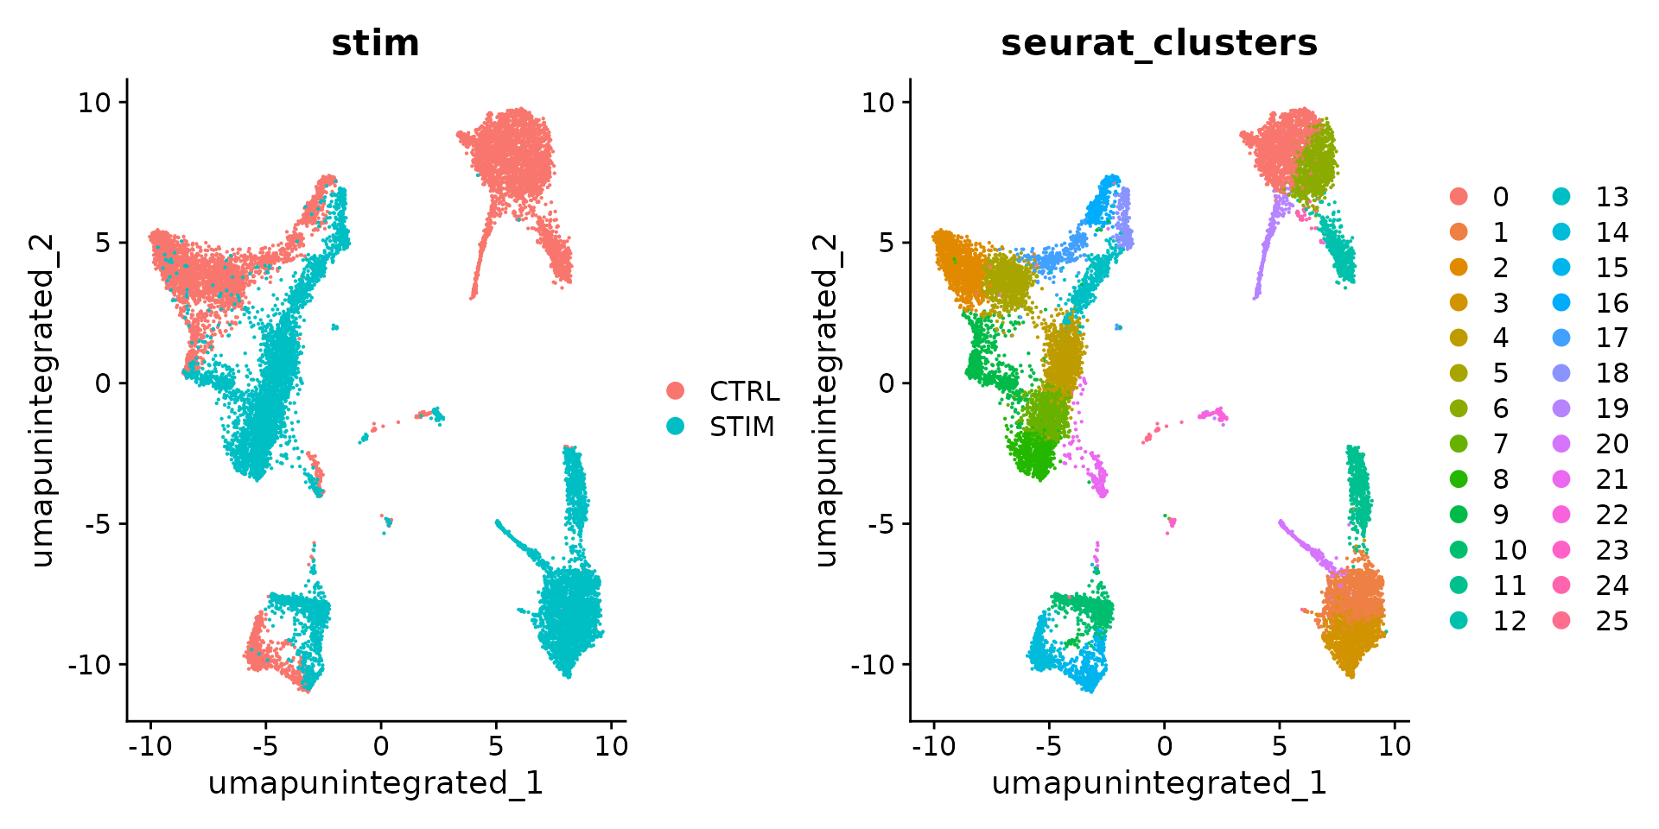
Unsupervised Clustering Without Integration
Clusters are defined by both cell-types and experimental group, complicating downstream analyses
Notes:
From: https://satijalab.org/seurat/articles/integration_introduction

Slide 12
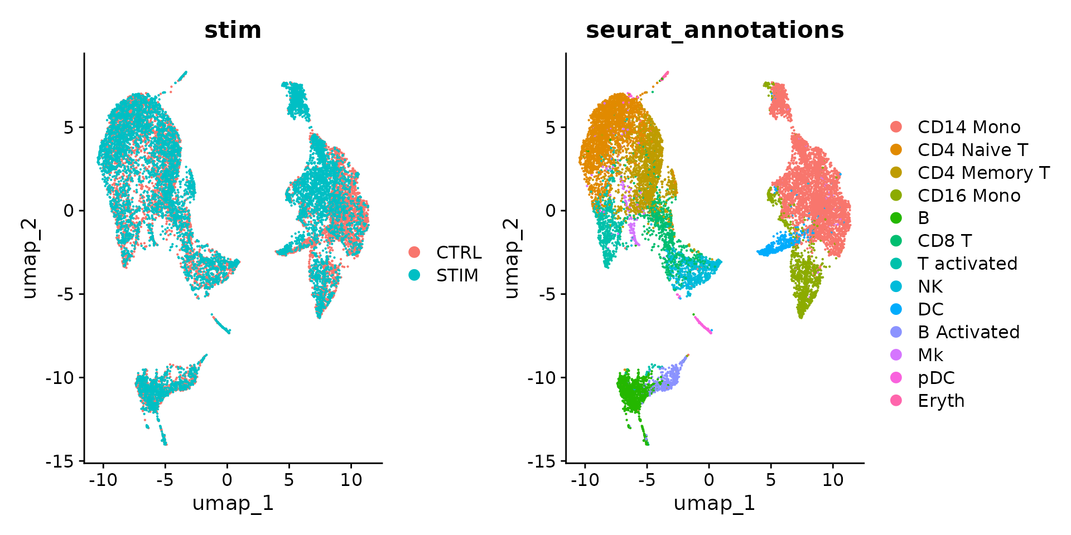
With integration – we can group cells by their shared biology, making cell type annotation and DE analysis easier
Notes:
From: https://satijalab.org/seurat/articles/integration_introduction

Slide 13
Integration Summary
Goal: To align same cell types across conditions.
Challenge: Aligning cells of similar cell types so that we do not have clustering downstream due to differences between samples, conditions, modalities, or batches
Recommendation: Go through the analysis without integration first to determine whether integration is necessary!
(see next slide)
Notes:
Taken from: https://hbctraining.github.io/scRNA-seq_online/lessons/06_integration.html

Slide 14
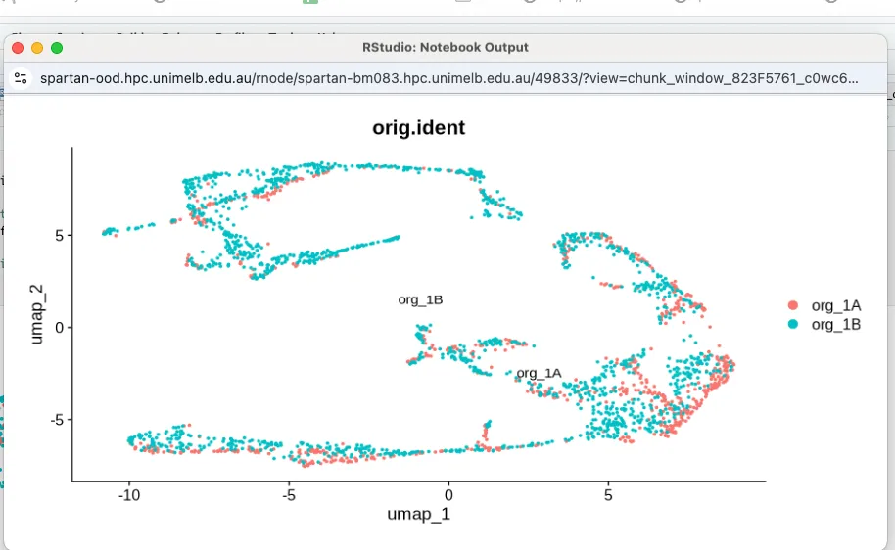
Integration Caveats – Decide first whether its needed
Integration can sometimes remove biologically relevant signals to artificially force cells to align.
However, it's not always needed and can be avoided with thoughtful experimental design.
Example:
The UMAP on the right shows two organoid samples at the same differentiation stage, processed and sequenced together.
In this case, integration would likely result in the loss of meaningful data, with little to no benefit.
(Unpublished data)

Slide 15
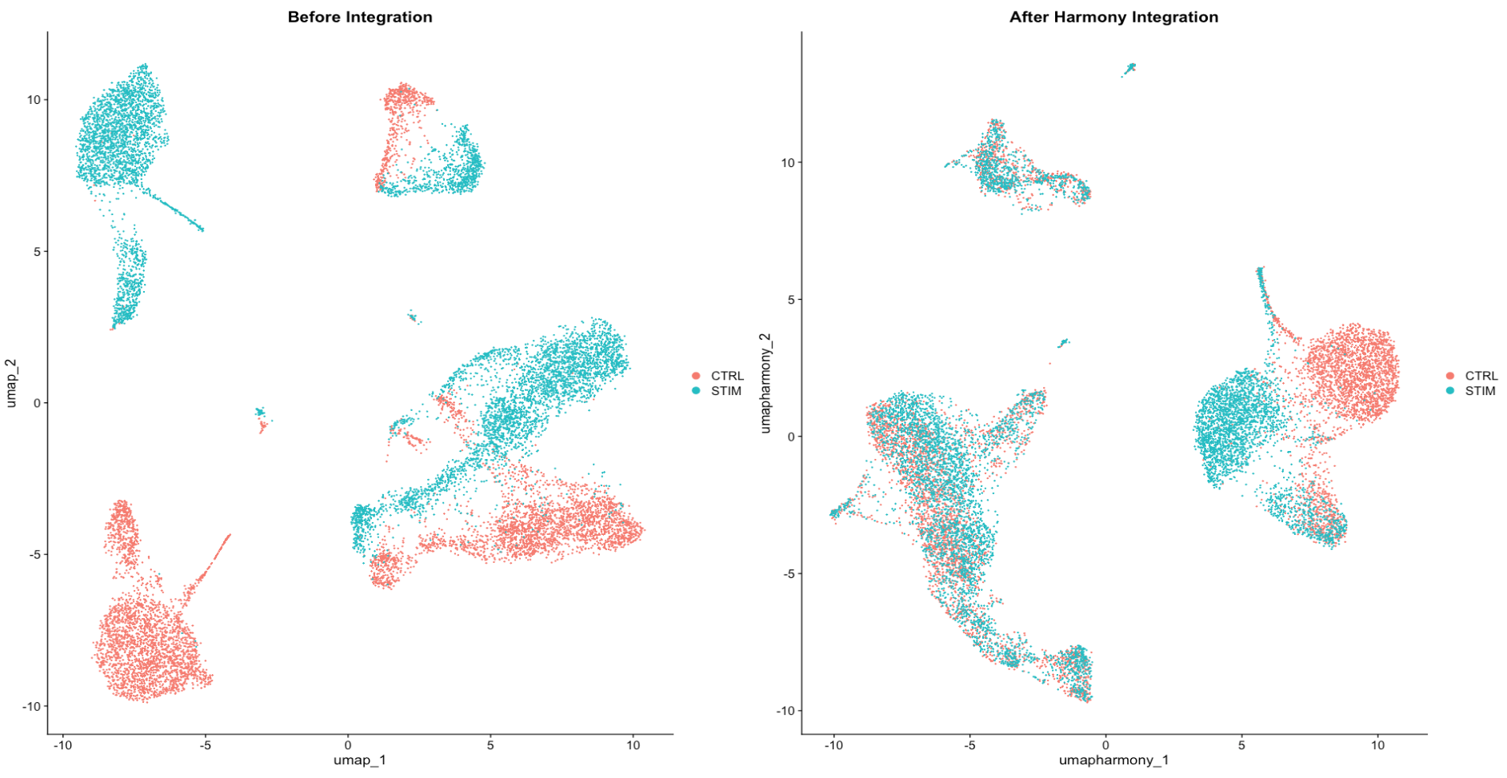
Discussion
How can we determine whether the integration method (shown on the right) has failed due to genuine cell-type differences between the two datasets?
Notes:
Try other integration methods
Look at markers for known cell types
Look at PC1 and PC2 plots coloured by experimental group

Slide 16
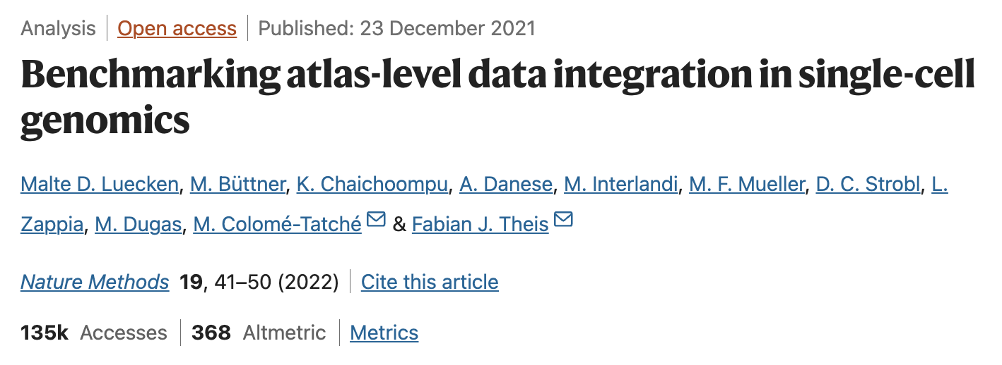
How do you decide on the integration tool to use?
The optimal integration method depends on the complexity of the integration task and dataset you are working with
Luecken et al. found that Harmony is good for simple integration tasks
For more complex data scenarios other integration methods may be better such as Seurat CCA

Slide 17
Differential Expression Analyses in Seurat
Normalise and Scale Data
Mary Piper, Meeta Mistry, Jihe Liu, William Gammerdinger, & Radhika Khetani. (2022, January 6). hbctraining/scRNA-seq_online: scRNA-seq Lessons from HCBC (first release). Zenodo. https://doi.org/10.5281/zenodo.5826256.

Slide 18
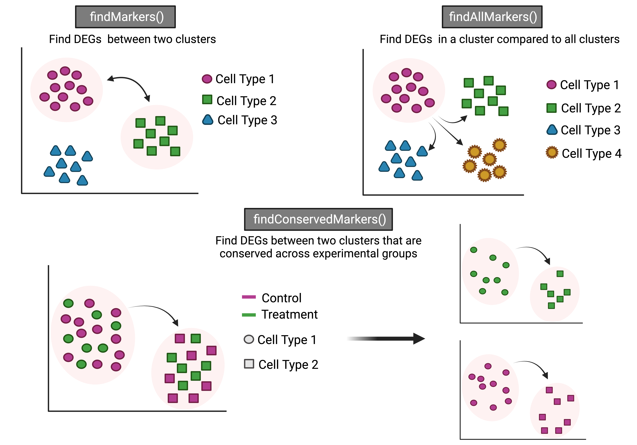
In-built Seurat Functions for DE Analysis
Notes:
https://www.youtube.com/watch?v=1i6T9hpvwg0
https://hbctraining.github.io/scRNA-seq_online/lessons/09_merged_SC_marker_identification.html

Slide 19
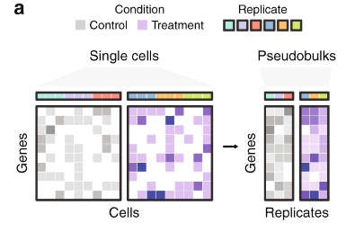
Pseudobulk Analyses – An alternative DE approach
Combines single-cell counts and metadata into 'bulk' count matrices at the sample or replicate level.
Advantages:
Uses well-established bulk RNA-seq tools (DESeq2, edgeR, limma).
Enhances statistical robustness by averaging out single-cell variability and reducing sparsity.
Facilitates straightforward DE analysis with familiar methods.
https://www.nature.com/articles/s41467-021-25960-2

Slide 20
Why use a pseudobulk approach?
scRNA-seq data is notoriously sparse, with a complicated distribution and substantial heterogeneity across and within cell populations.
Single-cell DE methods often struggle to identify low-expression DEGs and overemphasize highly expressed genes.
They also inflate p-values by treating individual cells as separate samples, reducing statistical reliability.
Pseudobulk analysis aggregates cells by sample, preserving cell-type resolution while allowing for the rigorous statistical testing available in bulk RNA-seq tools → leads to more accurate and robust differential expression findings.

Slide 21
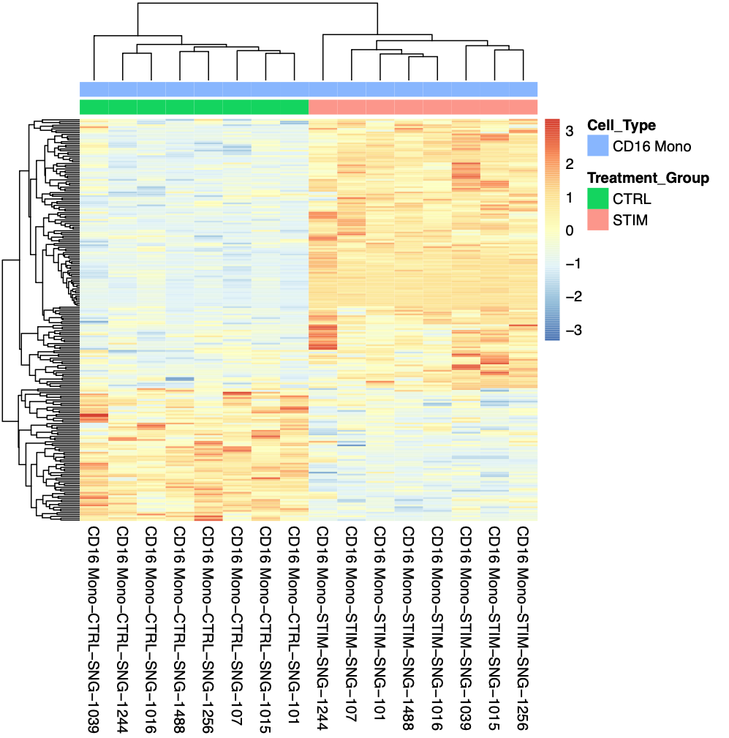
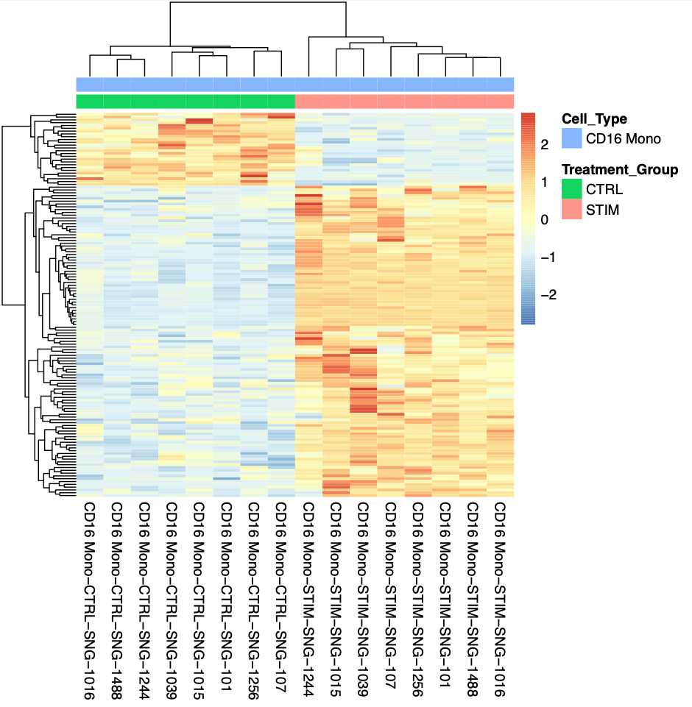
Discussion: Compare single-cell versus pseudo-bulk DE approaches
These heatmaps display the expression of differentially expressed genes (DEGs) along the y-axis, with cells grouped by patient replicates on the x-axis. Can you spot the differences?
DEGs found by Seurat single-cell method
DEGs found by DESeq2 pseudo-bulk method

Slide 22
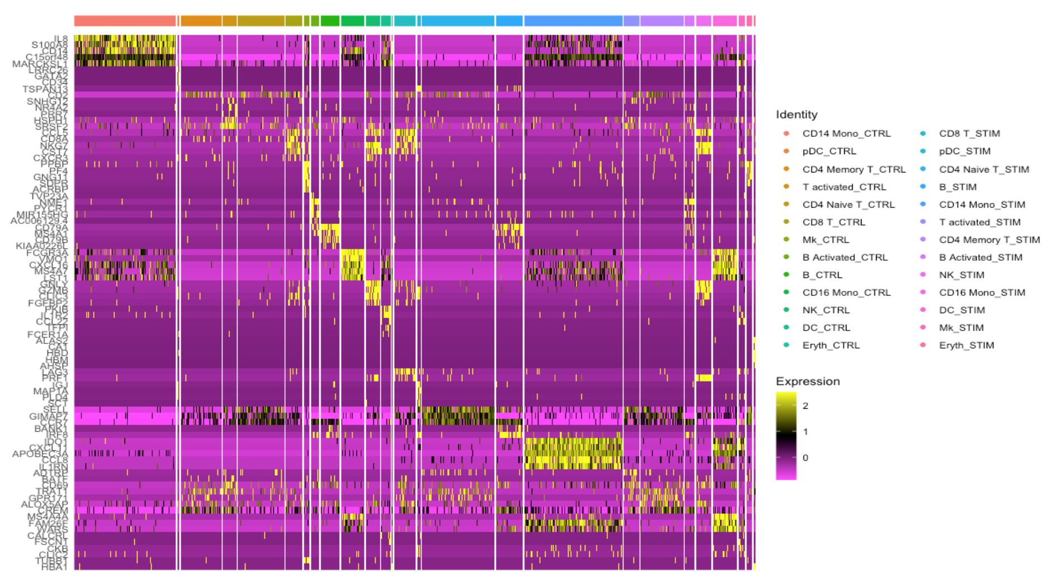
Walk Through: Extracting DEG data from Seurat to make custom visualisations with other packages (pheatmap)

Slide 23
What comes next?
1. Gene Ontology (GO) Enrichment Analysis
Perform GO enrichment analysis to identify biological processes, molecular functions, or cellular components that are significantly enriched in your DEG list.
Tools like clusterProfiler in R or DAVID can help you analyse and visualize these functional categories.
2. Pathway Analysis
Use tools such as KEGG, Reactome, or Ingenuity Pathway Analysis (IPA) to map your DEGs onto known biological pathways. This helps in understanding the broader biological context of gene expression changes.
GSEA (Gene Set Enrichment Analysis) can also be used to assess whether specific gene sets (e.g., pathways) are significantly enriched in your data.
3. Validation with External Datasets
Compare your DEGs with external datasets such as GTEx, TCGA, or publicly available single-cell RNA-seq datasets to validate your findings or explore how they relate to known disease states, tissues, or conditions.

